Slide 1
Monkeys in Research
Nick Snyder
Senior – Computer Engineering

Slide 2
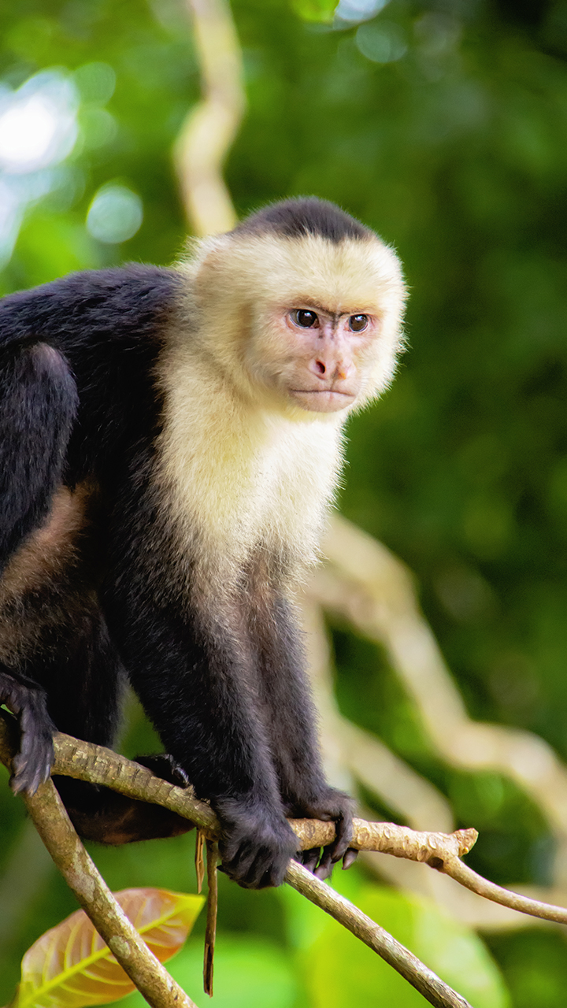
Monkeys in the wild
Found on 6/7 continents
Many species have been known to grasp parts of human language and use simple wood and stone tools
Many are endangered due to shrinking habitat
The long-tailed macaque was recently raised to endangered¹
Main niche is spreading seeds

Slide 3

Why are monkeys used?
Closest relative to humans. Have similar brains along with reproductive and immune systems²
Very popular for the research and development relating to conditions like AIDS and Parkinson’s disease
Helped develop COVID-19 vaccine

Slide 4

How many and where?
Sourced from Southeast Asia and Africa
Sent primarily to the US
For every 100 breeding females, around 60 monkeys will be born each year. A monkey is most suitable for research 2 years after birth³
The US is home to 7 major breeding facilities housing around 21,000 monkeys of various species

Slide 5
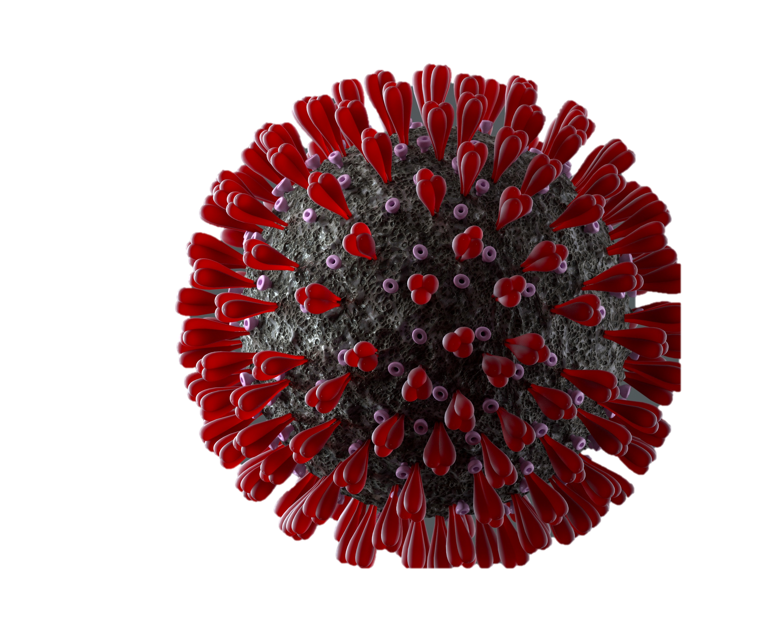
During the Covid Pandemic
Monkeys (NHP) were used to test efficacy of treatments such as Remdesivir and better understand the effects of contracting the disease⁴
At least 30 studies on COVID-19 have involved the use of monkeys
An unusually hot market for lab monkeys was fueled by the race to develop a vaccine to treat COVID-19 raised the Long-Tailed Macaque by 1333%
Led to an unprecedented increase in poaching activity after China banned the sale of wildlife in March of 2020. Between 2019 and 2021, the number of imported monkeys decreased ~6%.

Slide 6
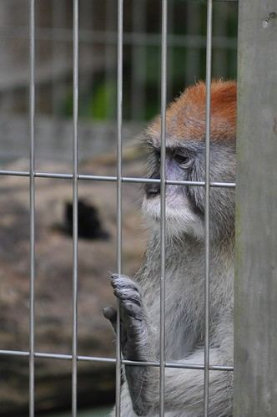
Consideration of the monkeys
No monkey wants to leave their home
Due to little over-sight makes it hard to prove monkeys are bred in captivity or taken straight from the wild. Cambodia’s share of the total number of imported monkeys rose by ~60%, prompting questions from experts about the true capability of the nation’s breeding farms
The number of deaths of monkeys from transport has risen despite less monkeys being imported

Slide 7
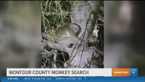
News report on missing monkeys⁵ (~1 min)

Slide 8

International reactions
Laos was banned from exporting long-tailed macaques in 2015⁶
Growing accusations of “monkey laundering” toward Cambodia after it was reported that in the night, monkeys were taken from forests and put into trucks disguised as transporting packs of ice to avoid authorities
Fear of government corruption has slowed investigations from international bodies
Many passenger airlines have stopped transporting monkeys

Slide 9
References
THE IUCN RED LIST OF THREATENED SPECIESTM. [accessed 2023 Jul 3]. https://www.iucnredlist.org/species/pdf/199563077#:~:text=The%20long%2Dtailed%20macaque%20is.
Covid-19 research using monkeys. 2020 Jun 26. European Animal Research Association. [accessed 2023 Jul 2]. https://www.eara.eu/post/covid-19-research-using-monkeys.
Schapiro R, Schecter A, Lehren AW, Anton L. Delgato. 2022 Dec 17. How the race for a Covid vaccine enriched monkey poachers and endangered macaques. NBC News. [accessed 2023 Jul 2]. https://www.nbcnews.com/news/race-covid-vaccine-enriched-monkey-poachers-endangered-macaques-rcna51970.2.
Kostus S, Hiller M, Nextar Media Wire. 2022 Jan 23. Truck carrying 100 monkeys crashes in Pennsylvania, escapees now accounted for. Fox4KC. [accessed 2023 Jul 2]. https://fox4kc.com/news/truck-carrying-100-monkeys-crashes-in-pennsylvania-escapees-now-accounted-for/.
Colley C. 2022 Aug 31. Inside the cruel macaque trade. The Ecologist. [accessed 2023 Jul 2]. https://theecologist.org/2022/aug/31/inside-cruel-macaque-trade#:~:text=Laos%20has%20previously%20been%20stopped,macaques%20was%20worth%20%241.25%20billion.

